Slide 1
Intra-EU labour mobility and social security coordination
Facts and figures
Frederic De Wispelaere
From 883 to the fair labour mobility package:
What prospects for balanced worker mobility within the EU?
CEPS and Permanent Representation of France - 2 December 2025

Slide 2
Facts and figures on …
  Intra-EU labour mobility
  EU coordination of social security systems
    Applicable legislation (Portable Document A1)
    ESSPASS
  E-declaration posting of workers
  Posted third-country nationals (TCNs)
  Subcontracting chains

Slide 3
Intra-EU labour mobility: a success story ...
The different faces of intra-EU labour mobility
  Active EU-movers: 7.2 million (3.5% of labour force)
  Frontier/cross-border workers: 1.8 million
  Seasonal workers: 650 000 – 800 000
  Posted workers: 2 million
  Highly mobile workers: 1.5 million
  Business travellers: 25 million trips for professional reasons
  Digital nomads / teleworking frontier workers
Source: Annual report on intra-EU labour mobility - 2024 Edition

Slide 4
… (mainly) thanks to EU coordination of social security systems
  The legal framework developed at EU level, mainly by means of the EU rules on the coordination of social security systems (i.e., Regulations 883/2004 (BR) and 987/2009 (IR)), plays a crucial role in safeguarding the social protection of persons moving within the EU.
  Applicable legislation:
    Article 12 BR (Posting) & Article 13 BR (Multi-state activities);
    The Portable Document A1 serves as proof that the person is covered by the social security system of the Member State which has issued the certificate.

Slide 5
Evolution of the number of PDs A1 issued, by type, 2007-2023
A significant increase in the number of PDs A1 issued under Article 12 (i.e., posting) since 2019
The increasing importance of PDs A1 issued under Article 13 (i.e., multi-state activities)
Source: PD A1 report – reference year 2023

Slide 6
Overview of some challenges
  ‘Law in books’ versus ‘law in action’: compliance and enforcement gaps
    Gap between formal requirements and actual practice: not all persons required to hold a PD A1 apply for it.
    Non-compliance with the ‘posting conditions’ (e.g., no ‘substantial activities’ in the sending Member State).
    Circumvention of Article 12 BR via Article 13 BR?
    Verification of posting conditions: serious doubts whether public authorities in the competent Member States verify posting conditions before issuing a PD A1 under Article 12.
    PD A1 as a ‘red herring’: holding a PD A1 does not guarantee compliance with terms and conditions of employment or payment of social security contributions.
    Withdrawal of the PD A1: this is only the beginning, not the end, of the story.

Slide 7
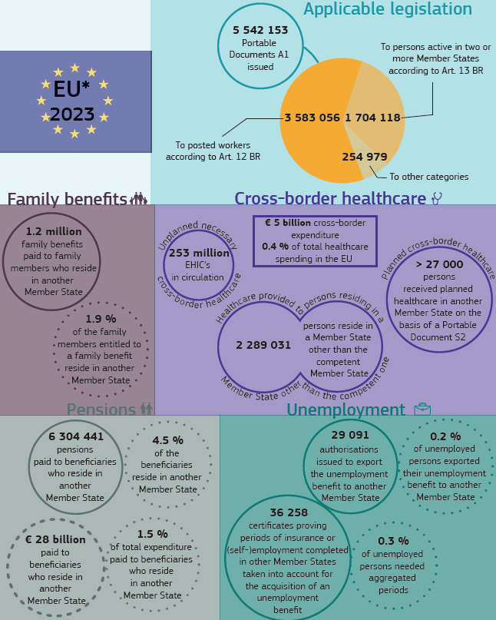
European Social Security Pass (ESSPASS)

Slide 8
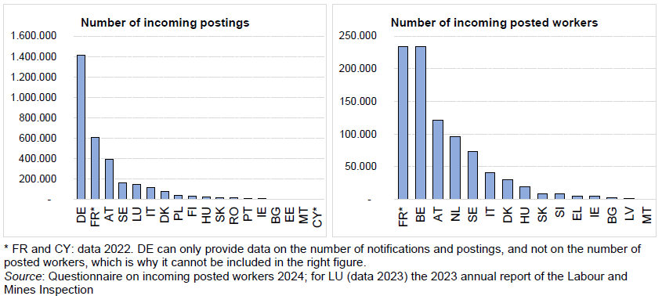
From 27 prior declaration tools to a single digital declaration portal for the posting of workers?
Draghi report : “While some companies temporarily post workers from one Member State to another to fill skills gaps, more efforts are still required to facilitate this activity, for example reducing the related administrative burden for companies”.
Source: Posting of workers - Collection of data from the prior declaration tools - reference year 2023

Slide 9
In 2023, third-country nationals (TCNs) accounted for, on average,
20% of incoming posted workers within the EU.
* Excl. Germany
Source: Posting of workers - Collection of data from the prior declaration tools - reference year 2023

Slide 10













A strong concentration within a number of ...
Sending Member States
Poland
Slovenia
Lithuania
Portugal
Receiving Member States
Austria
Belgium
France
Germany ?
Sectors of activity
Construction
Road freight transport
Live-in care
Agriculture

Slide 11
Overview of some main routes ...
Ukraine
Poland
Germany
Live-in care
Belgium
Construction
Lithuania
Road freight transport
Belarus
Poland
Road freight transport
Lithuania
Road freight transport
Bosnia - Herzegovina
Slovenia
Germany
Construction
Austria
Construction
Morocco
Spain
France
Agriculture
Brazil
Portugal
Belgium
Construction
France
Construction

Slide 12
Posting of TCNs: Is it a ‘business model’?

Slide 13
Posting of TCNs: Is it a ‘business model’?
Sending perspective
Slovenia
Lithuania
Overrepresentation
Overrepresentation of posted TCNs in total outgoing posted workers (63%) compared to the share of TCNs in the Slovenian labour market (14%)
App. 4 out of 10 TCNs are posted
Particularly in the construction sector
Overrepresentation
109 899 driver attestations in circulation at the end of 2023. More than 70 % of employed persons in road freight transport in LT.
Particularly in road freight transport

Slide 14
Posting of TCNs: some challenges
  Legal uncertainty
  See Position paper from The Netherlands, Belgium, Denmark, Germany, Italy, Latvia and Luxembourg ‘Foster genuine and fair posting of TCNs’.
  Non-compliance
  See Letta report: “Posted TCNs are a vulnerable group who run a higher risk of unfair, unhealthy and unsafe working conditions.”
  Infringements were found in roughly 60% of the inspections carried out by the Belgian labour inspectorates.
  Additional administrative burden
  Germany: Vander Elst visa
  CJEU C-540/22 SN and Others v Staatssecretaris van Justitie en Veiligheid

Slide 15
Subcontracting chains
  Subcontracting chains in the Belgian construction sector
  One in five subcontracting chains on large construction sites consisted of three or more levels of subcontracting;
  The longest chain reported consisted of seven levels of subcontracting;
  Of all subcontractors in the subcontracting chains, 20% were established abroad.

Slide 16
Subcontracting chains: country of establishment
  The lower you go in the subcontracting chain,
  the lower the share of subcontractors established in Belgium.

Slide 17
