Slide 1
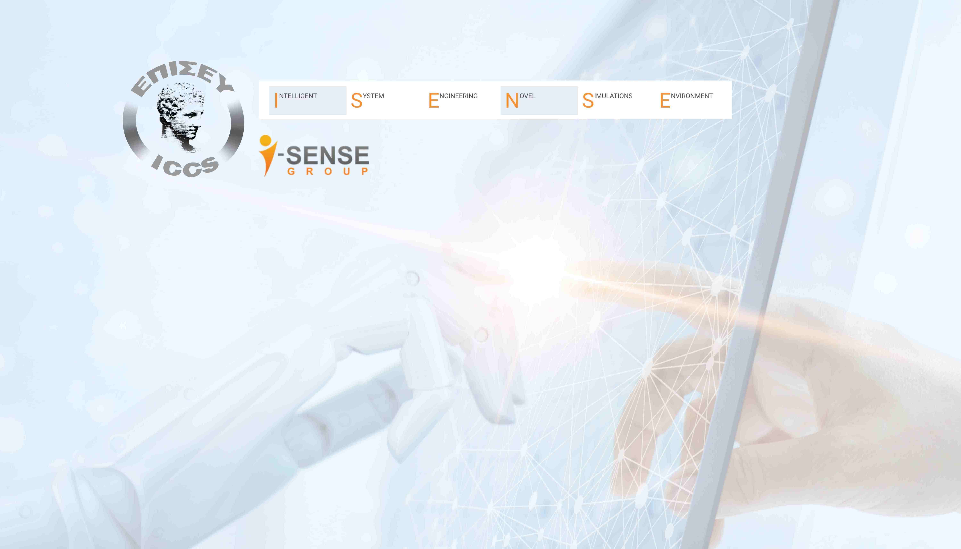



Digital Product Passport & Traceability:
Enabling Sustainability through Effective Policy
2nd ICCS Digital Product Passport event
Welcome & Introduction
Dr. Lucyna Lekawska-Andrinopoulou
lucyna.andrinopoulou@iccs.gr
Senior researcher, Division of Circular Economy and Tracing
Thursday 27th of November 2025
Centre for European Policy Studies (CEPS)
Place du Congrès 1, 1000 Brussels

Slide 2
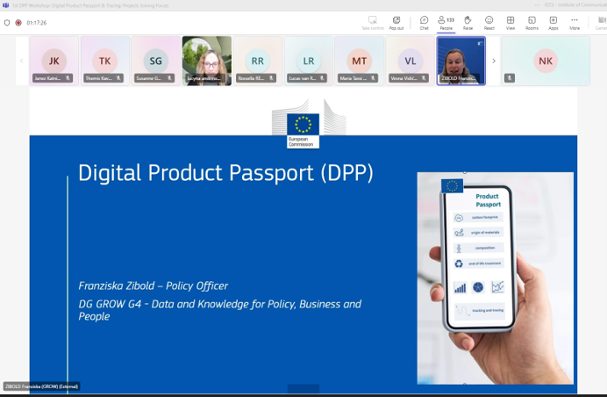
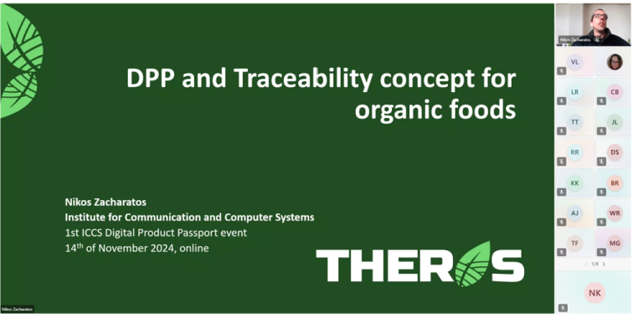
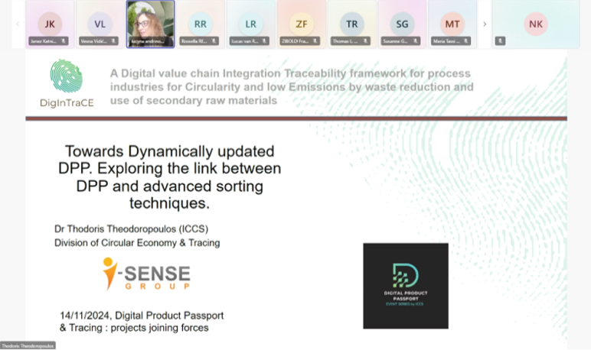

Digital Product Passport & Tracing: Enabling Sustainability through Effective Policy
2nd ICCS Digital Product Passport event
2nd event from a Digital Product Passport and Traceability series launched by ICCS and the Division of Circular Economy of I-SENSE Group
Event series was started by ICCS in 2024
  from need for cross-sectoral & cross project common approach for DPPs with topic: Projects joining forces
  no similar clustering event was organized back then in the DPP domain
  with 261 registrations and 153 participants participating online, average attendance time: 2h 16 min
ICCS aims to provide a platform to promote cooperation and ideas exchange, identify common challenges, strategies and novelties leading the transition towards a common approach for DPPs
ThePress
Presentation Template

Slide 3

Enabling Sustainability through Effective Policy
Policies shape how DPPs are implemented
They provide legal certainty for businesses
Policies ensure interoperability and standardisation
They drive market uptake and innovation
They safeguard transparency, data quality and accountability
Featured project
Wood2wood, Transforming wood waste into valuable resource for a greener future

Slide 4

Today’s agenda
Start | End | Topic | Speaker
9:00 | 9:30 | Registration and coffee
9:30 | 9:40 | Welcome and Introduction | ICCS
Policy developments
9:40 | 09:55 | Implementing DPPs for the transition to a Circular Economy | Thomas Ebert, EC | Thomas Ebert, EC
09:55 | 10:10 | Supporting interoperability of Digital Product Passport (DPP) Information Systems | Laetitia Montero, UNEP | Laetitia Montero, UNEP
10:10 | 10:50 | Discussion
10:50 | 11:20 | Coffee break
Challenges and opportunities: Insights from pilot cases
11:20 | 11:35 | Featured project W2W Enhancing Waste Wood Valorization with DPP Recommendations for Policy Makers | Themis Kavour, CERTH | Themis Kavour, CERTH
11:35 | 11:45 | Policy insights from DPP implementation in the wood waste, battery and textiles value chains | Vasileios Rizos, CEPS | Vasileios Rizos, CEPS
11:45 | 12:00 | The EU and Global Regulatory, DPP Industry & Standardization Landscape | Rembrandt Koppelaar, EcoWise | Rembrandt Koppelaar, EcoWise
12:00 | 12:30 | Discussion
12:30 | 13:00 | Poster session for DPP related projects
13:00 | 14:00 | Lunch break
Agenda

Slide 5

Digital Product Passport & Tracing: Enabling Sustainability through Effective Policy
2nd ICCS Digital Product Passport event
Today’s Agenda
WORKSHOP ROUNDTABLES
14:00 | 15:30 | Workshop 1 | Workshop 2 | Workshop 3 | ICCS, SAL
 |  | Governing DPPs: Resolving Ownership, Access, and Accountability | Designing DPPs: Data Models, Interoperability, and Policy Compliance | Enabling Innovation with DPPs: DPP policies changing the economics of green solutions
15:30 | 16:00 | Conclusions |  |  | ICCS

Slide 6

THANK YOU

Slide 7







ICCS and Digital Product Passport & Tracing
HE Projects with ICCS leading DPP/traceability component development (2023-2029)
This year’s featured project
DPP sectors: wood-furniture, textiles
Duration: 2023-2027
Coordinator: ICCS, Division of Circular Economy and Tracing
Integration of sensor info into dynamic DPP for steel value chain
DPP sector: steel
Duration: 2024-2026
Coordinator: RINA Consulting
Will be presented today
DPP sector: organic and GI food assets
Duration: 2023-2026
Coordinator: ICCS
First Circular Economy Hub in Greece
Kick off meeting: 3- day conference, December 2024
DPP sectors: textiles, plastics, construction
Duration: 2024-2029
Coordinator: ICCS, Division of Circular Economy and Tracing
4 hubs developing approach from Industrial Symbiosis to Hubs for Circularity
DPP sector: to be defined based on the hubs needs
Duration: 2024-2027
Coordinator: University of Twente
ICCS leading traceability component development
Will be presented today
DPP sector Construction
Duration: 2023-2027
Coordinator: ITeC

