Slide 1
Benefits and Costs
of Website-Blocking Legislation
An Economic, Legal and Policy Assessment
14 April 2026
J. Scott Marcus
Associate Senior Research Fellow, CEPS; Professor (part-time), Centre for a Digital Society, EUI
Artur Bogucki
Associate Researcher, CEPS; Assistant Professor, Warsaw School of Economics (SGH)

Slide 2
Motivation
In recent years, we have witnessed a proliferation of new EU Member State measures and cases that seek to block the access of the public to specific internet content.
These have been enacted at the Member State level, mainly in an effort to reduce online piracy – a genuine, challenging problem.
Costs and benefits imply difficult trade-offs due to
  the apparently limited effectiveness of these measures,
  the possible risk of overblocking,
  the costs they impose on network operators and service providers,
  the fragmentation implied by different and mutually inconsistent rules across the Member States, and
  tension between these rules and guarantees of freedom of expression.

Slide 3
Reasons to want to block content
There are many legitimate reasons to block internet content.
Some content may be illegal.
Some may be a manifestation of hybrid warfare.
A great deal of the noteworthy blocking in recent years has been motivated by the desire to reduce copyright infringement of audiovisual content, i.e. pirated streaming.

Slide 4
Modalities of content blocking
Different technologies
  IP address blocking,
  Domain Name System (DNS) resolver blocking, and
  Deep Packet Inspection (DPI) blocking
Different time frames in which they operate
  static,
  dynamic, or
  live (i.e. near real-time)
For each of these, there are many limitations and many possible circumventions.

Slide 5
Member State measures and cases
Many EU Member States (and the UK) have implemented blocking arrangements.
They differ from one another in numerous dimensions, including initial controls on blocking, rights of appeal, and the time frame in which blocking is implemented.
These divergent rules pose a challenge for cross-border operations.
In the jurisprudence of Court of Justice of the European Union, a key consideration for the permissibility of blocking obligations is the principle of proportionality.

Slide 6
Member State measures and cases
(continued)
Spain: private-entity delegation and fast-tracking
Italy: administrative speed and systemic collateral damage
Austria: the proportionality frontier
Belgium: market exit as collateral damage
France: established judicial blocking
The Netherlands: proportionality review and judicial scrutiny
The United Kingdom: proportionality as a benchmark

Slide 7
Attitudes and Practices of EU Consumers Regarding Copyrighted Online Content
In a survey of more than 25,000 EU individuals conducted by the EUIPO in 2023, 93% see value in copyright protection; however, 44% overall feel that strict protection of intellectual property curbs innovation, including 57% in the 15–24 age group.
Less than 10% of those surveyed felt that intellectual property enforcement benefits SMEs, or consumers like themselves.
In some (eastern) EU Member States, a majority feel that it is acceptable to obtain online content illegally for personal use.
  48% of EU respondents aged 15–24
  27% of those aged 55–64
  28% of those aged 65 and over.

Slide 8
Attitudes and Practices of EU Consumers Regarding Copyrighted Online Content
Some 14% of Europeans overall (or about one in 7) admit to having intentionally used illegal sources to access content online.
Some 33% of Europeans in the 15–24 age group admit to having done so.
Probably under-reported.
Of those who use online content from illegal sources, 43% report that lower prices might lead them to stop doing so; conversely, 44% report that they do not access content illegally because they can get the content they want via legal sources.
For films and music, solid peer-reviewed research supports the claim that the decline in illegal consumption can be attributed to increasing availability and decreasing prices over time.

Slide 9
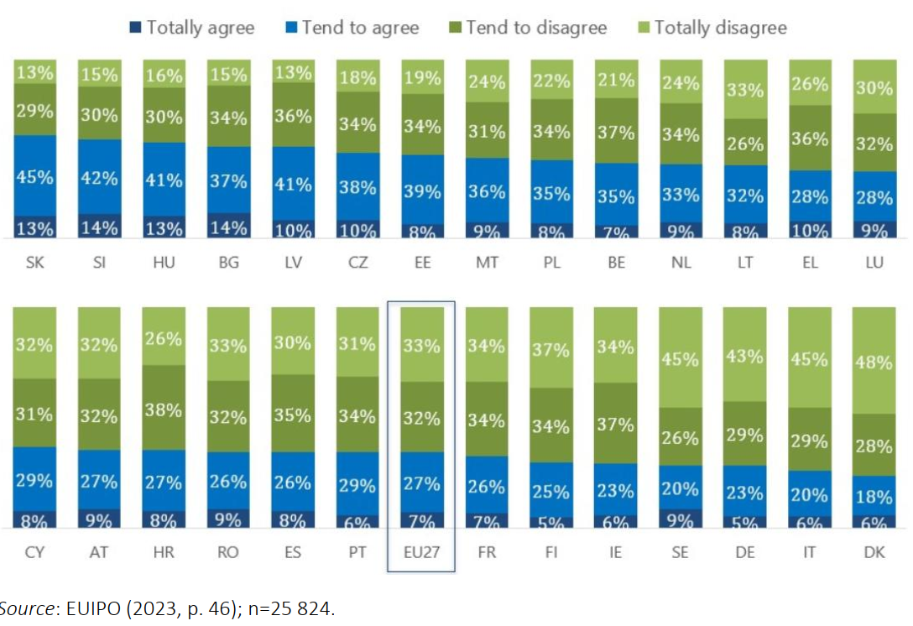
Attitudes and Practices of EU Consumers Regarding Copyrighted Online Content
To what extent do you agree that it is ‘acceptable to obtain online content illegally
when it is for your personal use’?

Slide 10
Harmful Side Effects
Past academic literature tends to suggest that website blocking generates only limited and short-lived positive effects – users are good at bypassing blockages, and pirate websites are good at migrating to unblocked venues.
A 2023 study found only small (but statistically significant) overall increases in consumption of legal content of 3% to 8% due to blocking in India in Brazil.
Website blocking regimes in the EU to date have consistently proven to be flawed and overly broad, owing to a combination of
  institutional shortcomings,
  technical limitations inherent to the blocking methods employed, and
  misaligned incentive structures.

Slide 11
Harmful Side Effects
(continued)
The burden of website blocking typically falls on parties other than those responsible for the infringement, such as
  network operators,
  providers of independent DNS resolution services,
  providers of content delivery networks, or
  very recently on providers of VPNs.
This poses challenges for global operators who run distributed infrastructure spanning many countries simultaneously, with limited ability to restrict a measure to users in a single jurisdiction.

Slide 12
Other Tools are Neglected
Policy to date has largely concentrated on limiting access to the supply of infringing content, without paying sufficient attention to the demand for infringing content, mainly because the current approach is painless for the rightsholders.
Many important tools are in the hands of the rightsholders themselves.
  EUIPO survey data suggest that 43% of those who use online content from illegal sources say that lower prices might lead them to stop;
  conversely, 44% report that the main reason they do not access content illegally is because the content they want is available via legal sources.
Most users are aware of legal offers, but users are not always clear as to whether a given offer is legal, so there is a role for education.

Slide 13
Other Tools are Neglected
(continued)
Availability and convenience are also crucial contributors to piracy, arguably even more so than price.
Geo-blocking can exacerbate problems with lack of convenient access to affordable content.
It will not always be possible to take action against the parties responsible for infringement, but whenever it is, that should be the preferred approach.

Slide 14
Recommendations

Slide 15
Key findings
Our analysis suggests that website blocking is associated with substantial risk of harmful side effects, which may not be fully appreciated by the Member State authorities issuing the blocking orders.
Rightsholders will tend to be quick to call for blocking solutions, because they bear none of the costs, which fall instead to providers of intermediary services.
It is up to policymakers to strike the right balance, ensuring that EU fundamental freedoms, including freedom of expression, are protected at the same time.
Piracy cannot be solved by blocking alone.

Slide 16
Recommendations to rightsholders
Rightsholders would be well advised to reflect on their pricing schemes and on any restrictions on availability and convenience (e.g. fragmentation across multiple platforms, plus geo-blocking) that they impose. Widespread availability of affordable content can help combat piracy. The gains to rightsholders flow not only from reduced piracy, but also from increased consumption due to the elasticity of consumer demand for content.
Whenever legally and practically feasible, rightsholders should first pursue infringers who reproduce their content without consent before addressing intermediaries.

Slide 17
Recommendations to the European Union
Measures to assist users in distinguishing legal from illegal content, including improved education, should be part of any comprehensive strategy to combat online piracy.
Whether content is illegal or infringing needs to be judged for the purpose of blocking under the laws of the country of use, not those of the country of origin.
Additional guidance at EU level on whether to block, and how, is called for, taking into account the principle of subsidiarity, the need to avoid fragmentation of the EU single market, and the growing need to avoid unnecessary burden on the sector (including on intermediaries that have little to do with any infringing content).

Slide 18
Recommendations to the European Union
(continued)
IP-based blocking should be avoided altogether. To the extent that blocking is used at all, better targeted mechanisms such as DNS-level or URL-level blocking should be used instead.
Reforms should be considered to better align incentives. Rightsholders should be required to contribute to the costs of implementing blocking measures, proportionate to the scale and complexity of the blocking requested, and they should bear liability for damages caused by overblocking implemented at their request.
Enforcement and coordination of the blocking of hybrid warfare content should be strengthened, and national regulators should be provided with sufficient technical capacity and clear guidance to ensure consistent implementation across the EU-27.

Slide 19
Recommendations to the Member States
Blocking orders should be subject to prior or rapid judicial review.
Blocking orders should be time-limited with periodic review, and the geographical scope should be clearly defined and limited as much as possible.
Any delegation of blocking authority to private entities must be accompanied by meaningful oversight and safeguards.

